Slide 1
Welcome! Web Accessibility Group (WAG) at AMAC
Janet Sylvia, WAG Leader
July 6, 2016

Slide 2
Questions
During presentation type questions in Chat
Q/A at end of presentation
(CTRL or CMD) M
Mouse: click in Chat box
Type your message
Press Enter on keyboard

Slide 3
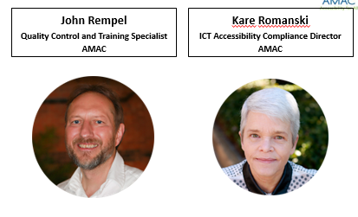
Today’s Presenters

Slide 4
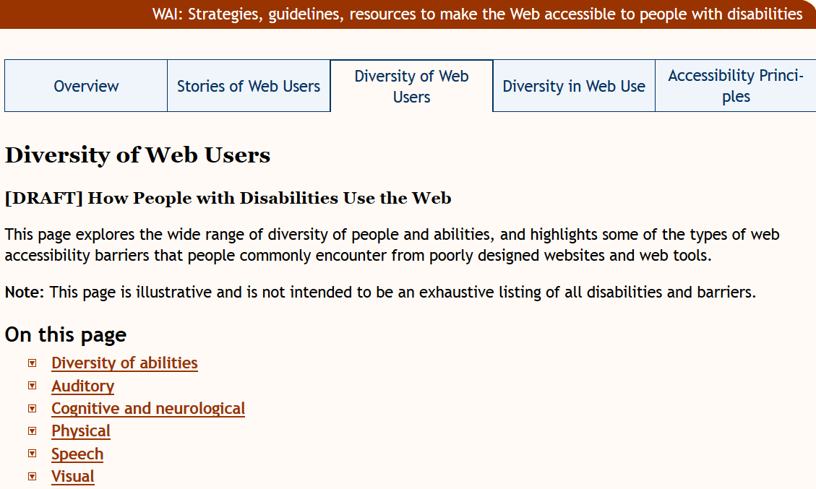
Disabilities Described in WCAG 2.0

Slide 5
Auditory
Mild or moderate hearing loss in one or both ears
Substantial and uncorrectable impairment of hearing in both ears
Auditory Disabilities – hear sounds but not always speech
Examples: Hard of hearing; Deafness; Deaf-blindness

Slide 6
Cognitive and Neurological
Disorders of any part of the nervous system including brain and the peripheral nervous system
This can impact how well people hear, move, see, speak and understand information
Does not necessarily affect the intelligence of a person
Examples: ADHD; ASD; Learning Disabilities; Mental Health Disabilities; Memory Impairments; MS; Seizure Disorders

Slide 7
Physical
Involves weakness, limitations of muscular control and sensation, joint problems, pain that impedes movement, or missing limbs
Examples: Amputation; Arthritis; Fibromyalgia; Rheumatism; Reduced Dexterity, Muscular Dystrophy; Repetitive Stress Injury; Tremors and Spasms; Quadriplegia

Slide 8
Speech
Difficulty producing speech that is recognizable by others or by voice recognition software
Examples: Apraxia of speech; Cluttering; Dysarthria; Speech Sound Disorder; Stuttering; Muteness

Slide 9
Visual
Includes mild or moderate visual impairment in one or both eyes, to substantial and uncorrected loss of vision in both eyes
Examples: Color Blindness; Low Vision; Blindness; Deaf-blindness

Slide 10
Mobile More Important Than Ever
Noisy Spaces
Using One Hand
Outdoor use in bright light
Small-sized touchscreens
Multitasking-Driving or Walking
All Ages Using Mobile

Slide 11
More than Just Phones & Tablets
Car interfaces
Videogame controllers
Smart watches
Emerging Markets

Slide 12
Where Do I Start???
A wide array of AT Products
Lack of experience using AT
So many browsers, operating systems and devices

Slide 13
Step Away from the Mouse!
Keyboard Accessibility Covers a Multitude of Sins
Tab and Reading Order
Visual Focus
Interactive Form Controls
Keyboard-Triggered Event Handlers

Slide 14
AT: Limitless Options, Limited Time
Common AT Testing Tools for Desktop/Laptop
JAWS
NVDA
VoiceOver for the Mac
Dragon Naturally Speaking (DNS)

Slide 15
Screen Readers: Why All the Fuss?
Critical Stops Abound for Inaccessible Sites
Accessibility for Screen Readers = Accessibility for Many Other AT Solutions
Liability and Powerful Advocacy Groups
Some Examples of Exceptions: Deaf and Hard-of-Hearing; Cognitive and Neurological Considerations; Low Vision and Color Blindness

Slide 16
NVDA: Pros and Cons
Pros:
FREE!!! – Open Source
Lightweight: fewer system resources used
Frequent Updates: Quarterly
Cons:
Lack of technical support
Lacks compatibility with 3rd party applications
Less frequently used in education and workplace than paid screen readers
Poor quality synthesizer by default

Slide 17
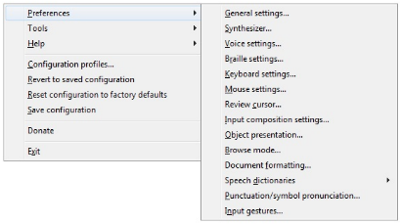
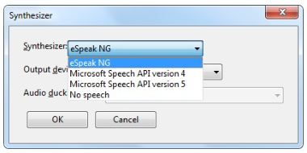
Changing NVDA Synthesizer
Change Default Synthesizer:
Select Preferences from Menu
Select Synthesizer…
Select “Microsoft Speech API version 5”

Slide 18
JAWS: Pros and Cons
Pros
Largest market share
Excellent Technical Support
Extensive scripts developed for 3rd party applications
Cons
Expensive
Tries to fill in “Accessibility Gaps” – Problematic for testing
Lack of portability/versatility with installation

Slide 19
Essential NVDA Shortcuts
NVDA Key: Insert or Caps Lock
Stop: Control
Quit: NVDA + Q
Faster/Slower: Control + NVDA + Up/Down Arrow
Previous/Next Line: Up/Down Arrow
Read Current Line: NVDA + Up Arrow
Read All: NVDA + Down Arrow
Forms/Links: Tab
Headings: H
Graphics: G
Buttons: B
Landmarks: D
Tables: T
Navigate Table Cells: Control + Alt + Arrow Keys
Toggle Forms Mode: NVDA + Space

Slide 20
Essential JAWS Shortcuts
JAWS Key: Insert
Stop: Control
Quit: Insert + F4
Faster/Slower: Control + Alt + Page Up/Page Down
Previous/Next Line: Up/Down Arrow
Read Current Line: Insert + Up Arrow
Read All: Insert + Down Arrow
Forms/Links: Tab
Headings: H
Graphics: G
Buttons: B
Landmarks: R
Tables: T
Navigate Table Cells: Control + Alt + Arrow Keys
Toggle Forms Mode: Enter

Slide 21
VoiceOver Shortcuts
VO Key: Control + Option
Stop: Control
Rotor: VO + U, then Left/Right Arrow
Speech Rate: VO + Command + Left/Right Arrow
Previous/Next Item: VO + Left/Right Arrow
Heading: VO + Command + H
Table: VO + Command + T
Graphic: VO + Command + G
Activate Link/Form Control: VO + Spacebar

Slide 22
Browsing Common Browsers
JAWS
IE 11
Firefox
NVDA
IE 11
Firefox
VoiceOver
Safari

Slide 23
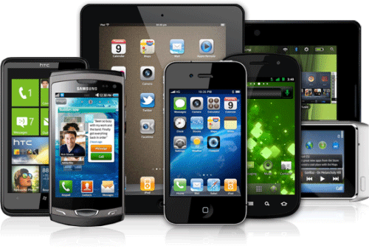
Smartphone and Tablet Testing
What to Test On?
Consider Analytics
Consider Complaints Being Received
iOS: VoiceOver
Smartphone: iPhone
Tablet: iPad
Browser: Safari
Android: TalkBack
Smartphone: Nexus
Tablet: Nexus
Browser: Firefox

Slide 24
Gestures for iOS and Android
Essential Gestures with iOS
Essential Gestures with Android

Slide 25
Testing with Peripheral Devices
Compatible BlueTooth Keyboard
One Option: Universal Mobile Keyboard (MS)
Essential Shortcut Keys with iOS
Essential Shortcut Keys with Android

Slide 26
Additional Resources
Paul J. Adam: Web and Mobile Accessibility Resources
WebAIM: Using NVDA to Evaluate Accessibility
WebAIM: Keyboard Shortcuts for NVDA
WebAIM: Using JAWS to Evaluate Accessibility
WebAIM: Keyboard Shortcuts for JAWS
WAI’s Web Accessibility Perspectives
AMAC’s AccessGA: Web Accessibility in Action

Slide 27
Our Presenters

Slide 28
Best Testing Tool
The best accessibility testing tool is
knowledge!

Slide 29
Effective Evaluations
Effective evaluation includes:
Establishing clear requirements and conformance levels
Ensuring a common understanding among team members (designers, developers, content providers)
Establishing a review schedule during the design and development processes
Providing information on evaluation approaches so that both designers, content providers and developers can perform preliminary reviews on their own

Slide 30
Accessibility Testing Methods
Methods to test for accessibility with varying levels of detail:
Browsers often have an Add-on for a quick accessibility checks
Software tools are available
An in-house checklist can be a helpful aide for repeated projects, similarly a Compliance Matrix
The service of an external company or expert can be beneficial
The Web Accessibility Preliminary Evaluation provides detailed guidance on how to check for accessibility

Slide 31
Effective User Evaluations
Evaluate websites/apps with real people to understand accessibility issues
Evaluate with users with disabilities and with older users to identify usability issues that are not discovered by conformance evaluation alone.
Involve users early in web projects ensures better and easier accessibility
Involve users with disabilities and have accessibility specialists evaluate in planned repairs can catch any problems before they are propagated throughout your site.
Include users throughout the development process to complete sample tasks on prototypes can assist in understanding how the different aspects of the design and coding can be improved.

Slide 32
Training
Training and Support is critical to success
Solutions need system-wide training & support
Develop skills over time and need
Train users
Provide materials and examples
Resolve issues
Applying/understanding of standards & guidelines
Remember, for most accessibility:
Is only one of their many job duties
Can’t be learned/fully understood overnight
Needs to be introduced over time

Slide 33
Accessibility Testing
A sound testing strategy combines functional and structural testing during the entire product lifecycle and automated testing at the end of the development lifecycle to create an accessible product and reduce the cost. Three checkpoints should occur during the design, template creation and template integration stages.

Slide 34
Design Checkpoints
Web site accessibility can be measured at stages throughout its development
Stages of web development lifecycle for most projects include:
Design – visually check designs before going to template stage
Flexible Layout - allows the layout and/or text to 'scale' to the user's window size
Consistent Layout – (navigation/layout) consistently drill down to all levels
Color Contrast - between text/background colors for known color blindness conditions
Structure Outlined – (Information Architecture) little to be done a11y-wise at this stage

Slide 35
Template Creation Checkpoints
Stages of web development lifecycle for most projects (continued):
Templates created - the foundation from which all the pages on the site will be made, where the most WCAG checkpoints occur
templates should undergo a full check on code, cross-browser compatibility and accessibility compliance
user-checks - W3C's validator and accessibility tools are useful at this stage to test the templates
Many items still require human checks to see what is appropriate
Valid Code
Separating content from presentation
Structural mark-up
Skip links
Technologies used
Relative units
Language markup
Keyboard use
Avoid moving or flickering content
Scripts – graceful degradation (basic functionality works without JavaScript)
works with a keyboard as well as a mouse (basic functionality works without JavaScript)
works with a keyboard as well as a mouse

Slide 36
Template Integrated Checkpoints
Stages of web development lifecycle for most projects (continued):
Templates integrated – CMS (check at end of stage) ensure templates have been successfully integrated. Allow plenty of time as it may involve making changes to the system!
Initial content added - Allow some time for updates to the design to account for unforeseen content types. Include a good sample of content to give an impression of what it will look like
Site launch - check that the pages match the templates now that the content is included. Note: Some CMS have trouble creating valid code that matches templates, and WYSIWYG editors used by the systems can output inaccessible code
Further content added - Not allow images to be added without an alternative text, or highlight those that are missing the text
Provide contextual help advising how suitable alternative text might be chosen
Centrally manage alternative texts for all images.
If these checks are not in place, content editors need to know how to apply alt text to an image, and the type of description that would be suitable.

Slide 37
Template Integrated Checkpoints (cont.)
Stages of web development lifecycle for most projects (continued):
Other aspects of accessibility that editors need to know about are:
Correct use of headings;
Correct use of quotes and acronyms;
Correct use of tables;
Marking any change in the language of sections in the text (i.e.; French)
Appropriate link text

Slide 38
Total Automation
There are five issues that can be fully assessed by an automated process, and which are actually better assessed automatically:
Valid code
Identify the language of a document
Don't use server-side image maps
Avoid deprecated HTML elements
Associate labels with their controls in the code
These items are all code-issues with no need for human interpretation, which is why automated checks are best for these issues.

Slide 39
Partial Automation
Another 8 issues can be partially assessed by automated tools:
Alternative text - can check for existence, not for suitability
Use relative units - can check for the existence of non-relative units, but not whether they make a difference to display
Ensure pages work without scripts - can check for scripts, but not whether the page works for a user
Use device independent scripts– can check for mouse or keyboard only scripts, but not whether they actually work for people
Do not create automatically refreshing/redirecting pages - some can be detected, but there are many possible methods that may escape detection
Clearly identify the target of each link - can check whether link text is repeated for links to different pages (e.g. 'click here'), or if the same page is linked to by different text. However, many instances found by checkers do not affect people.
Links
Links - same page with different link text (e.g. a link in the main navigation is replicated in the content with different text)
Links not separated (a priority 3 issue where links should have a non-link separator in between)
Headings not nested correctly (e.g. having a heading level 3 following a level 1)

Slide 40
Test Early and Test Often
Three (3) rules to automated accessibility testing
Test early and test often
Don't return false positives
Always test the DOM
Automation needs to be a time saver
It should detect the problems that you can fix without the need for further investigation
Most accessibility testing tools return a mix of issues that are clearly errors and others that require human verification
Note: A false positive is any result which either presents a problem which isn't actually an accessibility error or a result that presents a potential problem.

Slide 41
The Value of Automated Testing
The ability to automate something is limited by our mental capacity to perform that task.
We can only automate the things we understand, that are simple enough and repeatable enough.
Automated tests | Manual tests
Automated tests are repeatable and consistent | Manual tests can be unpredictable different testers may produce different results testers may use workarounds to avoid some bugs
Automated tests and testing platforms can be easily scaled as the code base grows | Manual testing isn’t scalable - employing more people is the only option
Automated tests can be executed concurrently against many environments | An individual tester can only (sensibly) test one environment at a time
Automated tests can provide rapid feedback on system/code changes | Manual tests are slow - feedback might take days, weeks or months
Some things can’t be automated or doesn’t need automation.

Slide 42
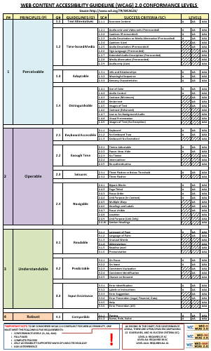
WCAG Conformance Chart

Slide 43
Resources
Evaluating with users with disabilities
Involving users early in web projects ensures better and easier accessibility
Involving users with disabilities and having accessibility specialists evaluate
Role of Web Designer
Diversity of web users
Web Accessibility Initiative Interest Group

Slide 44
Questions???
1) Type questions in Chat
(CTRL or CMD) M
Or using mouse click in the Chat box
Type your message
Press Enter on your keyboard to send message to Main Room
2) Ask Questions via Microphone
Raise your Hand to be part of the question queue
Select Hand icon (above participant names)
We will take questions in order received

Slide 45
WAG - Upcoming Meetings
First Wednesday
11:00am – 12:00pm (noon) EDT U.S.A.
Next Meeting
September 7, 2016
Suggest a topic for future meeting:
wag@amac.gatech.edu

